Slide 1
Notes:
8min Motivation
Mesh-Up-Fähigkeiten für die eigene Plattform anbieten
Nutzer motivieren angebotene Services über das Web hinaus zu nutzen
Kreativität der Nutzer ausnutzen (Web 2.0 Gedanke)
Ihnen die Möglichkeiten geben großartiges mit deinen Services zu verwirklichen
Zum Nachdenken über eigene Services anregen
12min: InstantSVC Features, Überblick
Natürlich dürfen diese zusätzlichen Schnittstellen keinen Mehraufwand bedeuten
Wenn man das Anbieten von Web Services in der Architektur berücksichtigt führt das oft zu klarerem Design (stärkere Schichtung)
Kann auch für AJAX genutzt werden, als Basis für Web 2.0 Oberflächen ;)
werkzeuggestützte Entwicklung notwendig für effiziente Softwareentwicklung
Konfiguration statt Programmierung
10min: Vorstellung der Tools und Gimmicks, Call-Graphen als Eye-Catcher
15min: Einfaches Beispiel: Der Web Service für deinen Anrufbeantworter, Fernabfrage

Slide 2
About the Project
  Base Project developed by 6 HPI Students since October 2005
    G. Gabrysiak, Ch. Hartmann, M. Perscheid, M. Sprengel
    Today Here: Stefan Marr and Falko Menge
  Project presented at the FrOSCon 2006
  Open Steps: contribute base to eZ Components
  Additional Work
    Access Control in Service Oriented Architectures
    Implementation of Task-Role Base Access Control based on ServiceMix/Java and InstantSVC
Notes:
Think this slide goes here to show our experiences and qualifications on this topic
Anything to say about your work for TUK?

Slide 3
Agenda
  Motivation
  Short Introduction to InstantSVC
    Architecture, Features
    Tools
  Live Demo: Adding a Web Service

Slide 4
Quick Survey
  Who of you is developing web applications?
  Who uses PHP?
  What kind of applications?
    Content Management
    eCommerce
    Collaboration Tools
    “Enterprise Applications”
    Other?
Notes:
After the quick survey:
Now lets think of your apps in parts of functionality.
These parts can be called services.
Now we speak not only about services for people, but also about services for other applications.
→ Next slide, samples of possible services referring to survey results

Slide 5
Services?
  Blog with Web 2.0 Stuff
    Feeds, Publishing API, User Contribution, Single-Sign On,…
  Shops
    Catalog of Goods, Buying API, Availability Checks
    Intention: Close the Media Gap
  Enterprise Applications
    Finance, Warehouse Management, Human Resources,…
  Services provided by Specialists
    Used to build Applications upon

Slide 6
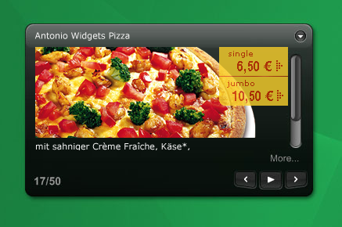
Services: For Whom?
Enterprise People
Innovators
  Portals and Mesh-Ups
    Personalization
    Single-Point-Of-Access
    Tools for there Employees
  Composite Applications
    Workflows for their Customers
    Quick and Cheap, but with convincing Quality
  It is cool
  Everybody wanne have it
  Is it Flickr, del.icio.us, Digg, Google Maps, Ebay?
  Likely, it’s not!
  You did not imagine what's possible with your services
  They Do!
Notes:
Who did like to build Apps based on your services?
You don’t imagine, but you’ll make them pay for your services, so you’ll earn money and get something to eat.

Slide 7
Wish List of a Service Developer
  Easily enhance existing applications
    Low-Cost/Effort: because benefit might not be instantly visible
  Support for latest Technologies and all possible Flavors
    SOAP and REST as non-exclusive Options
  Security
    Well, try it without guy ;)
  Nice and Nifty Tools
    They have to be sexy, and easy to use

Slide 8
What does PHP provide?
  SOAP
    The very basics, Client and Server
    No Tools, no PHP2WSDL Generation
  REST
    Well, PHP is REST at its heart
    But people don’t know it, so they need Tools
  No Security
    Access Control is an Application issue

Slide 9
InstantSVC:
Basic Features
  PHP is an dynamic language
    Extended Reflection API with Information about Types
    Annotations for PHP
  Service Description for Service Consumers
    WSDL Generator conform to WS-I Basic Profile
  Services as Add-On to existing Applications
    Document/Literal Adapter Generator
  Security
    Implementation of WS-Security and Username Token Profile

Slide 10
InstantSVC:
Convenience Features
  For SOAP Services
    Handler Chain Mechanism for SOAP Processing
  For REST Services
    Custom Mapping of Functionality to REST Resources
    Custom Serialization Handling
  Administration Tool for convenient Creation und Management of SOAP and REST Services

Slide 11
Administration Front-End
  Administration Front-End
    Automated Creation of Web Services from existing Applications
    Annotations identify Classes to be used
    Administration via Web Browser
      Classes and Methods selected by User
      Generates SOAP and REST Server Scripts
      Generates WSDL File and Adapter Classes
      SOAP Server with WS-Security

Slide 12
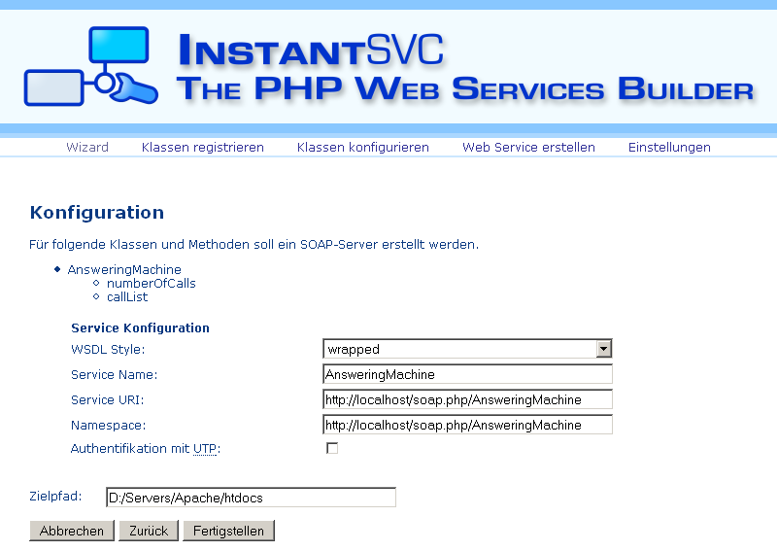
Administration Front-End

Slide 13
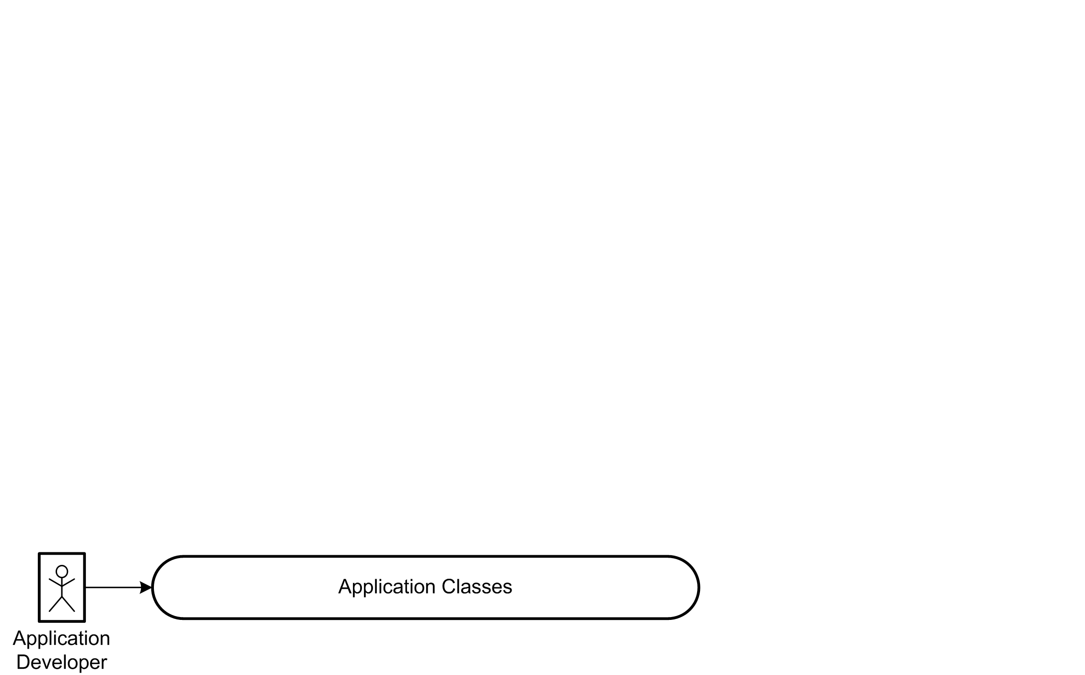
Interaction Overview

Slide 14
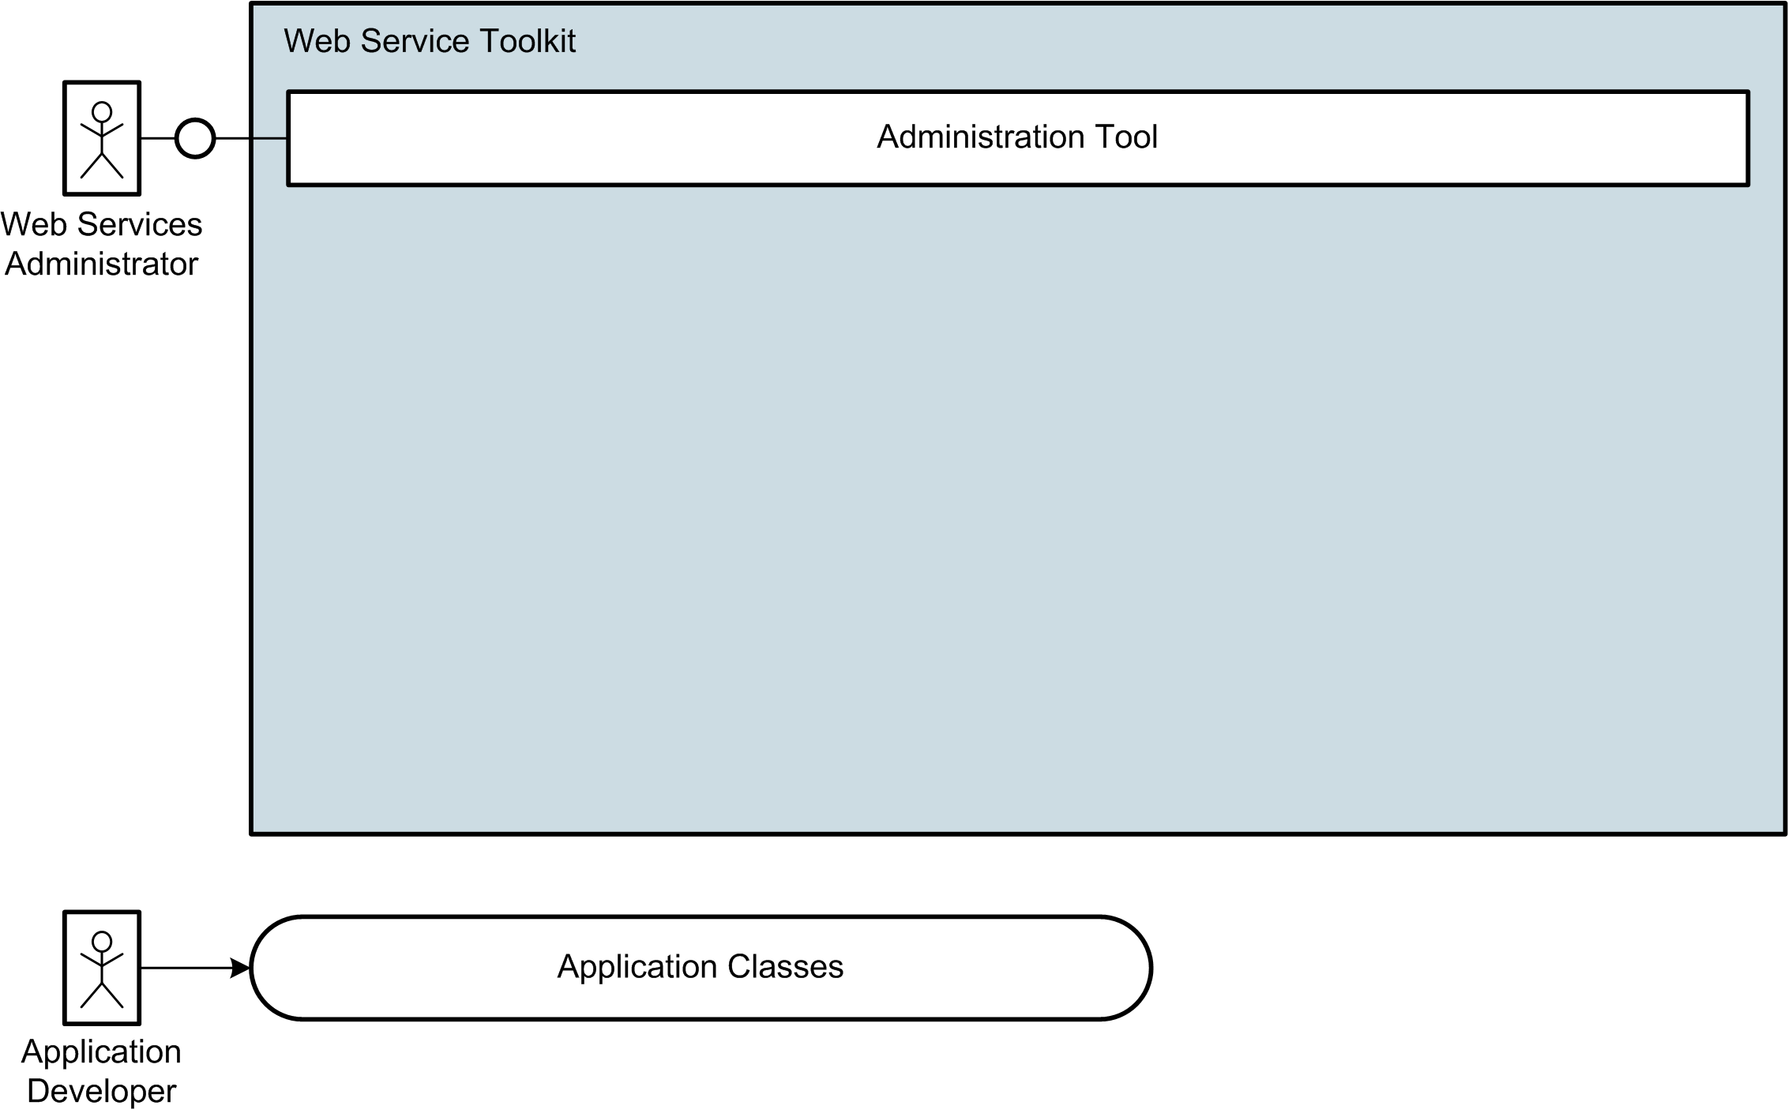
Interaction Overview

Slide 15
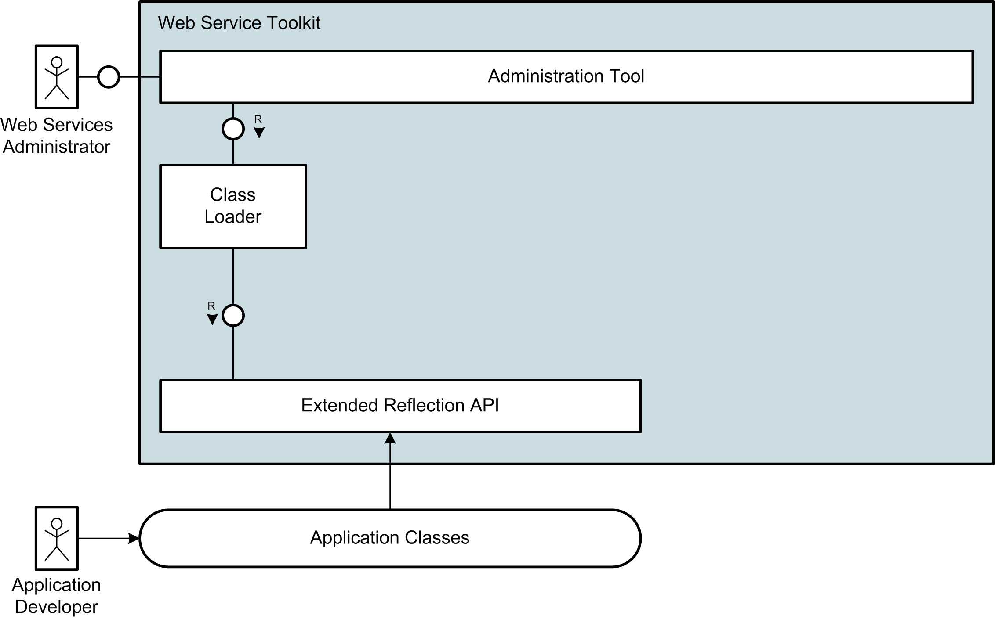
Interaction Overview

Slide 16
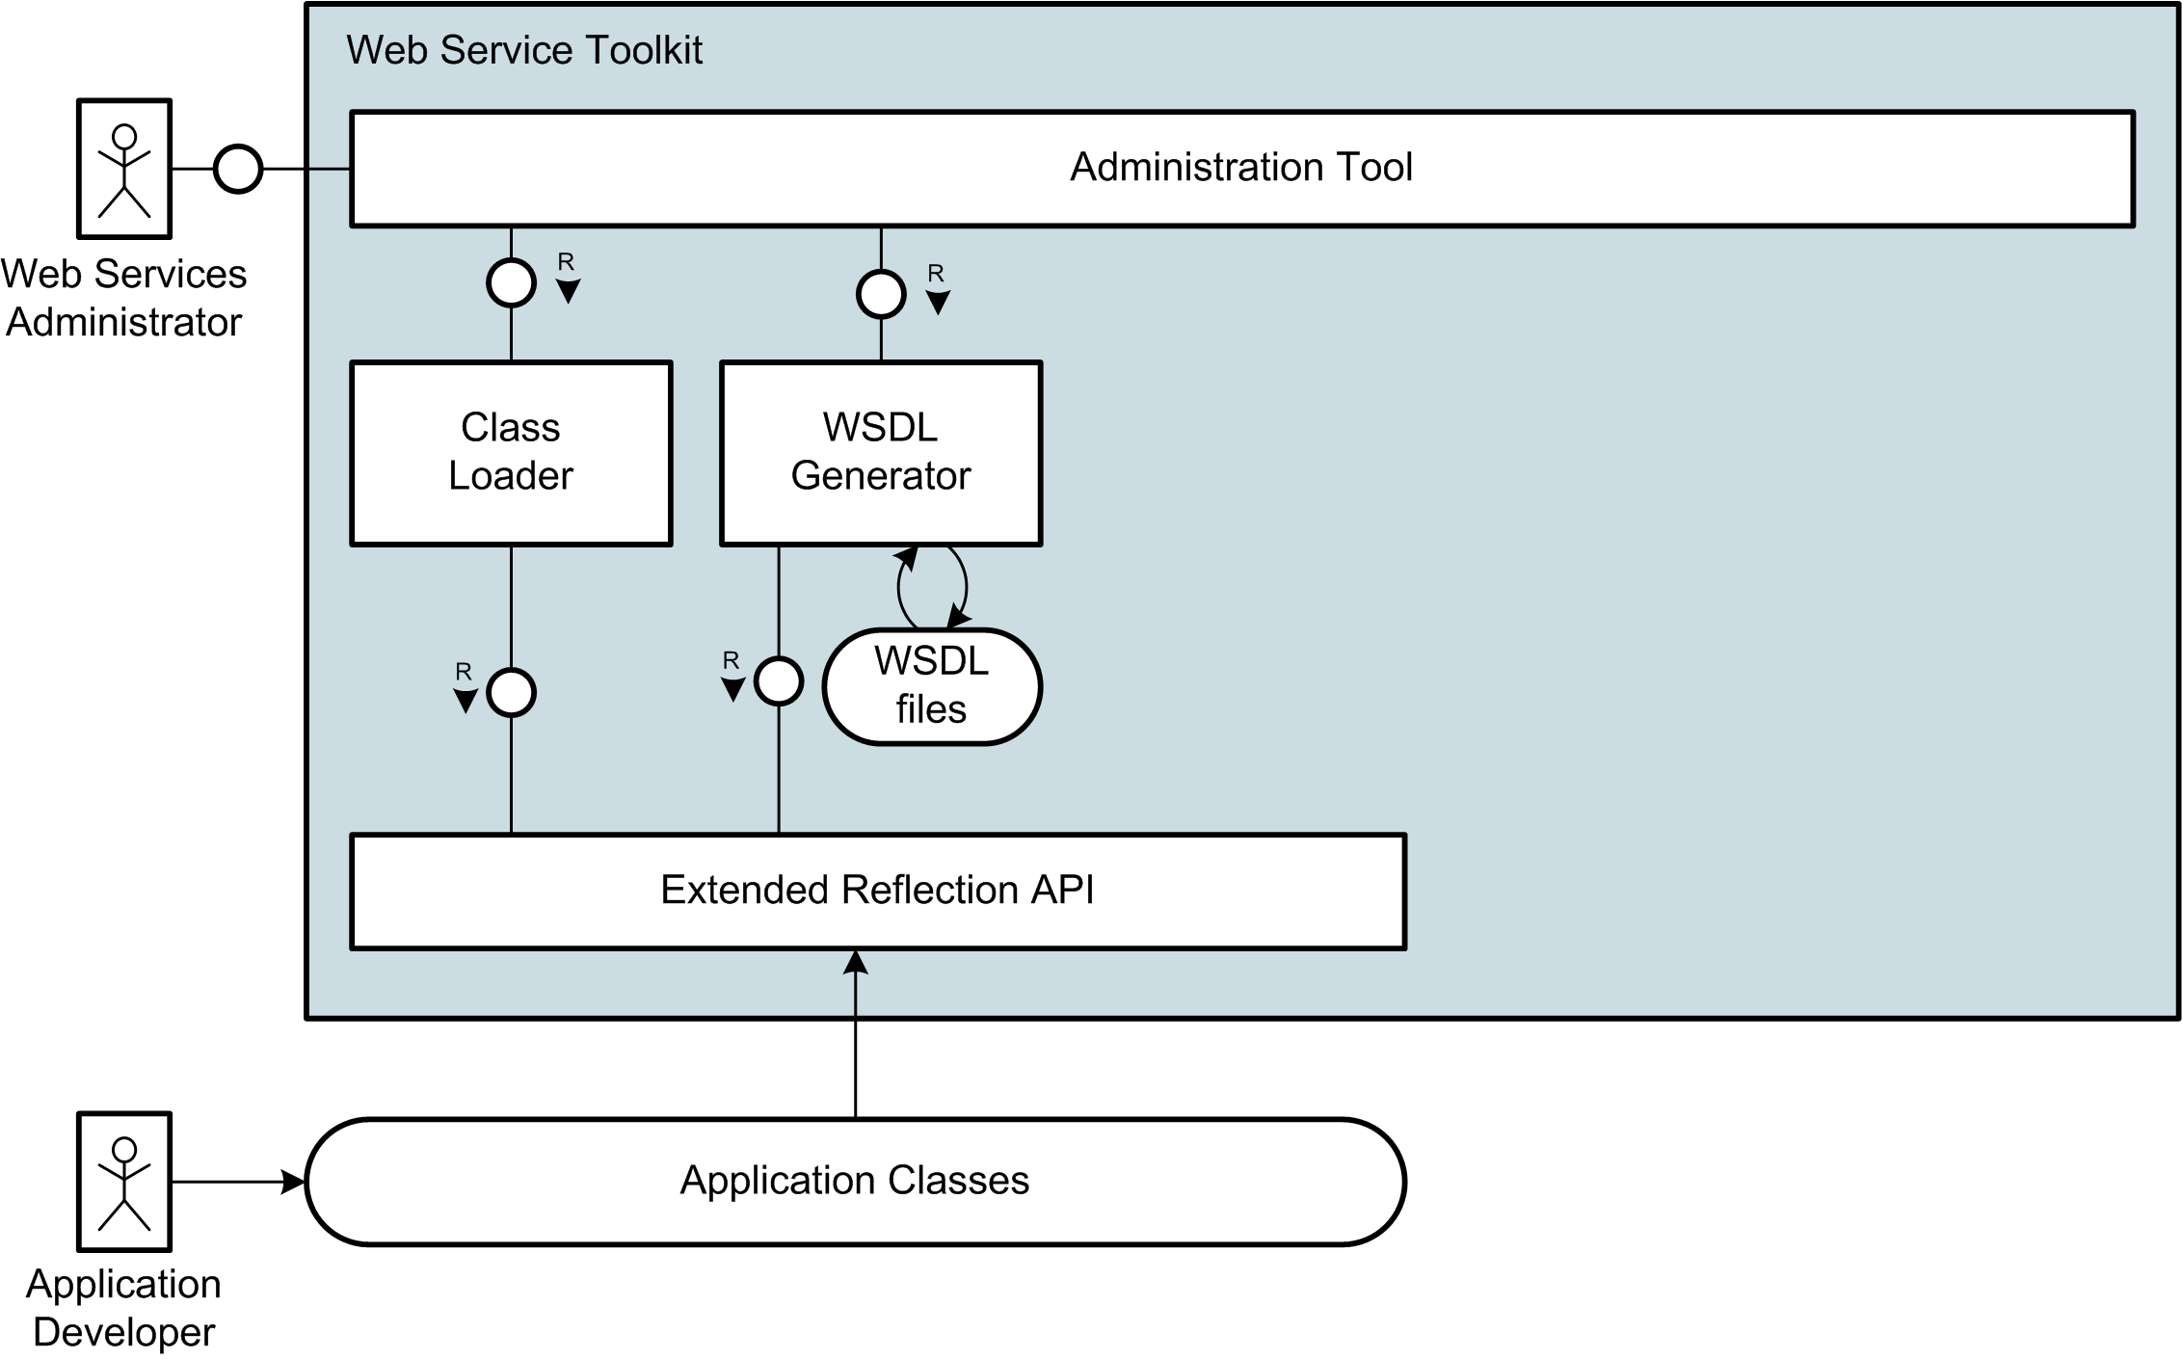
Interaction Overview

Slide 17
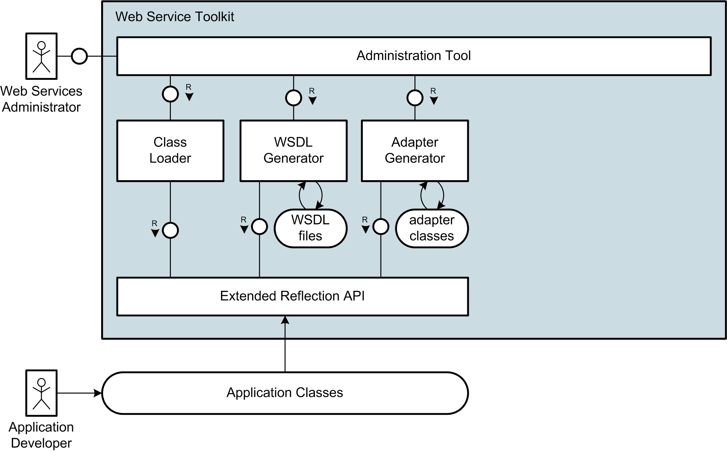
Interaction Overview

Slide 18
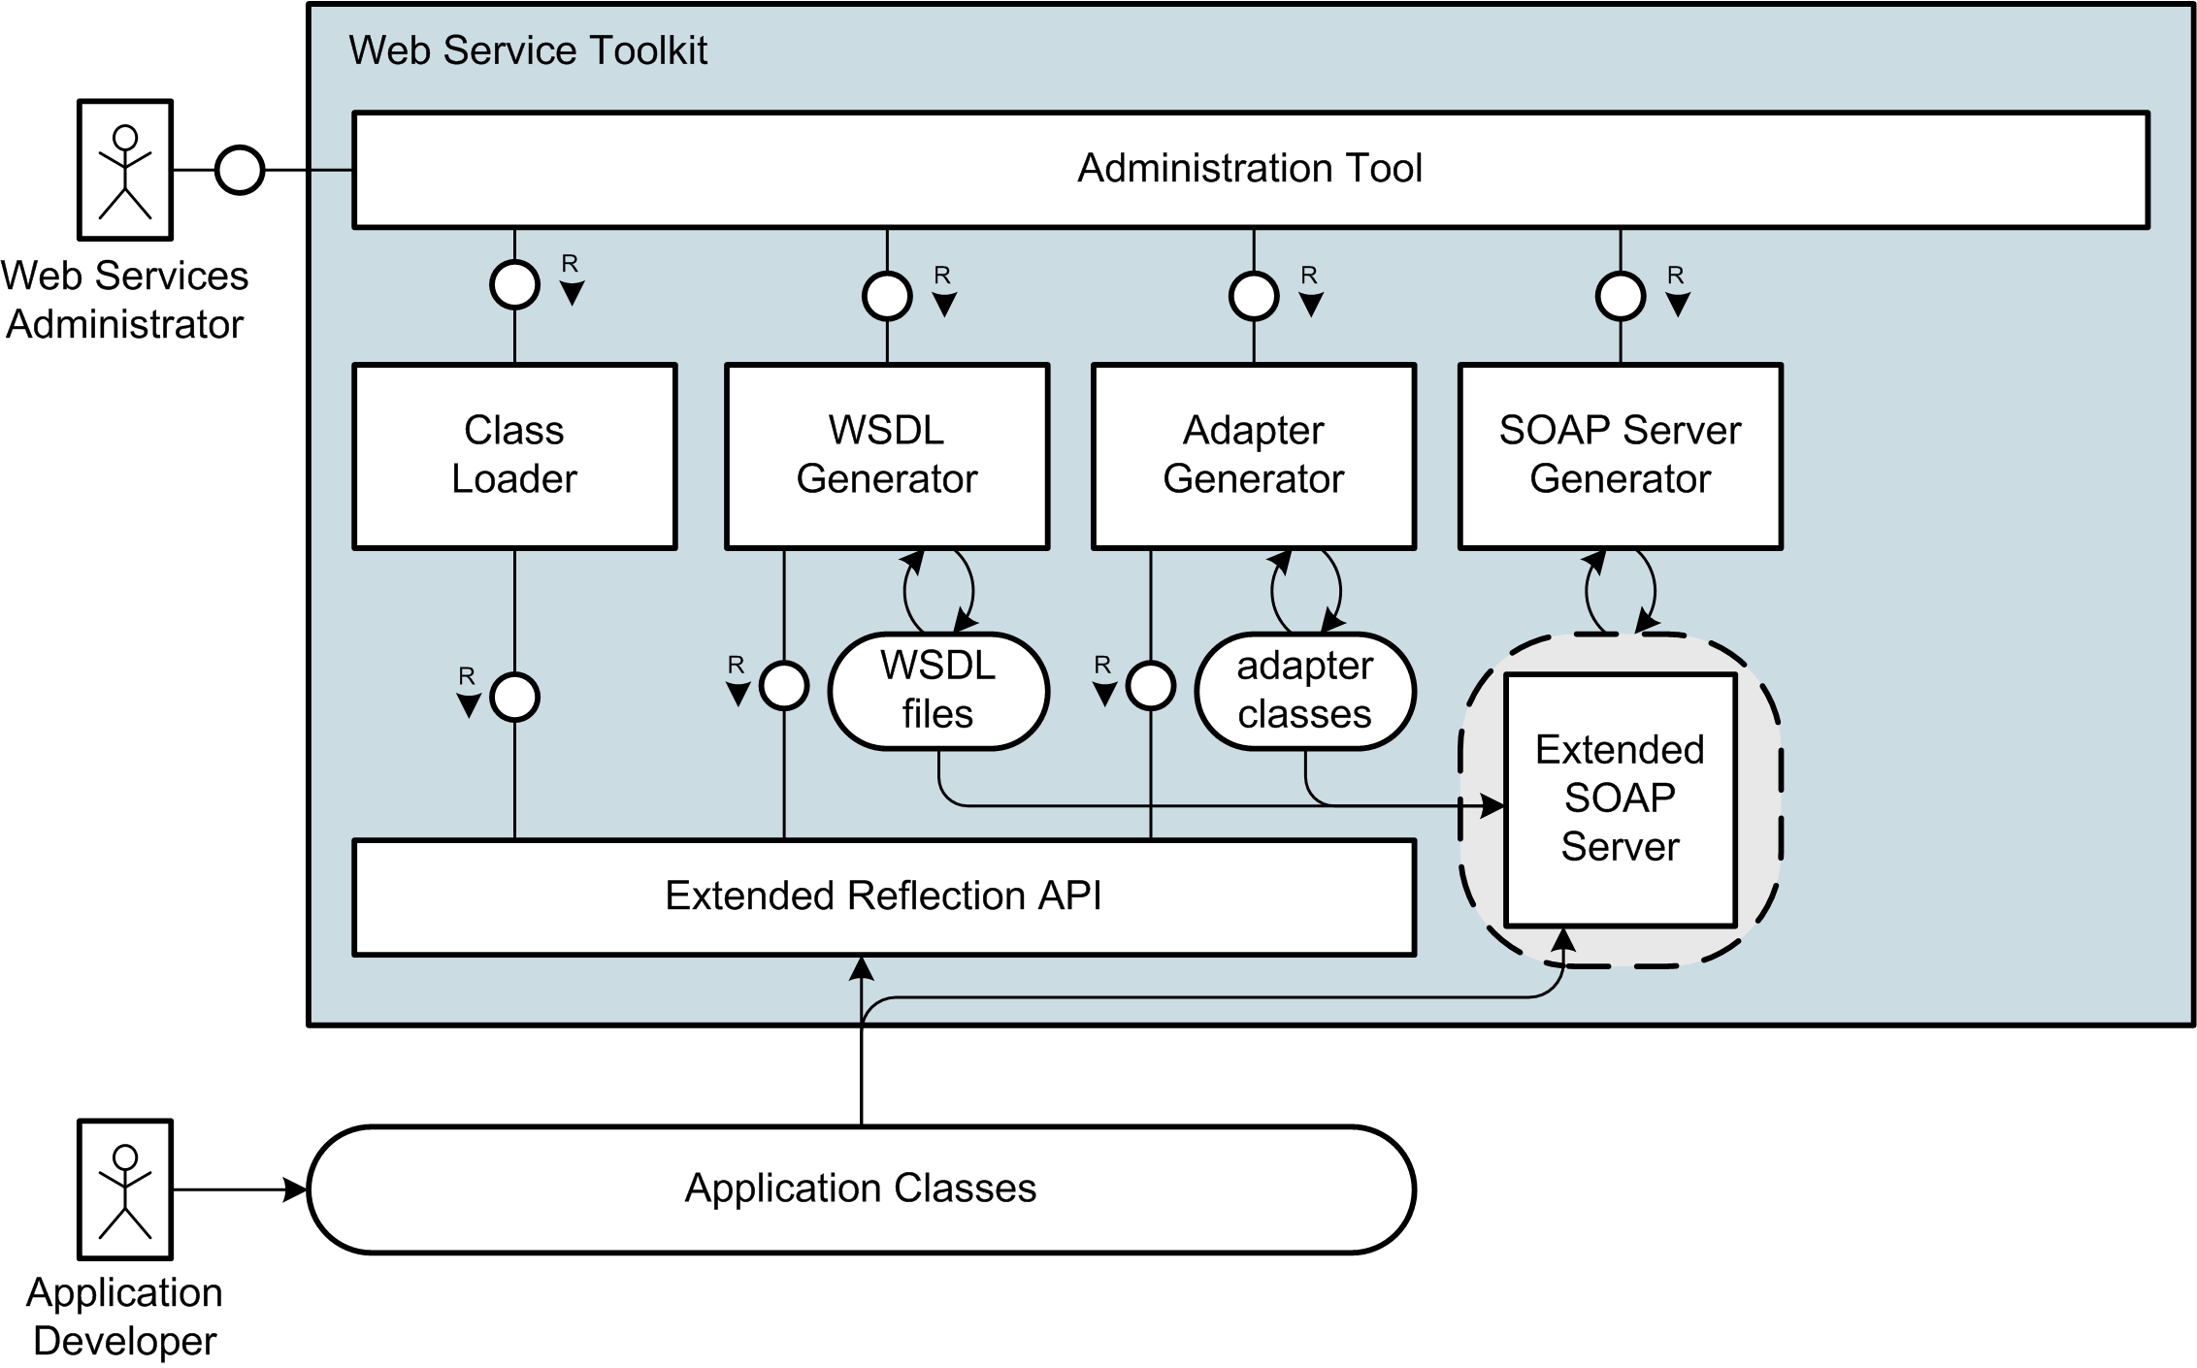
Interaction Overview

Slide 19
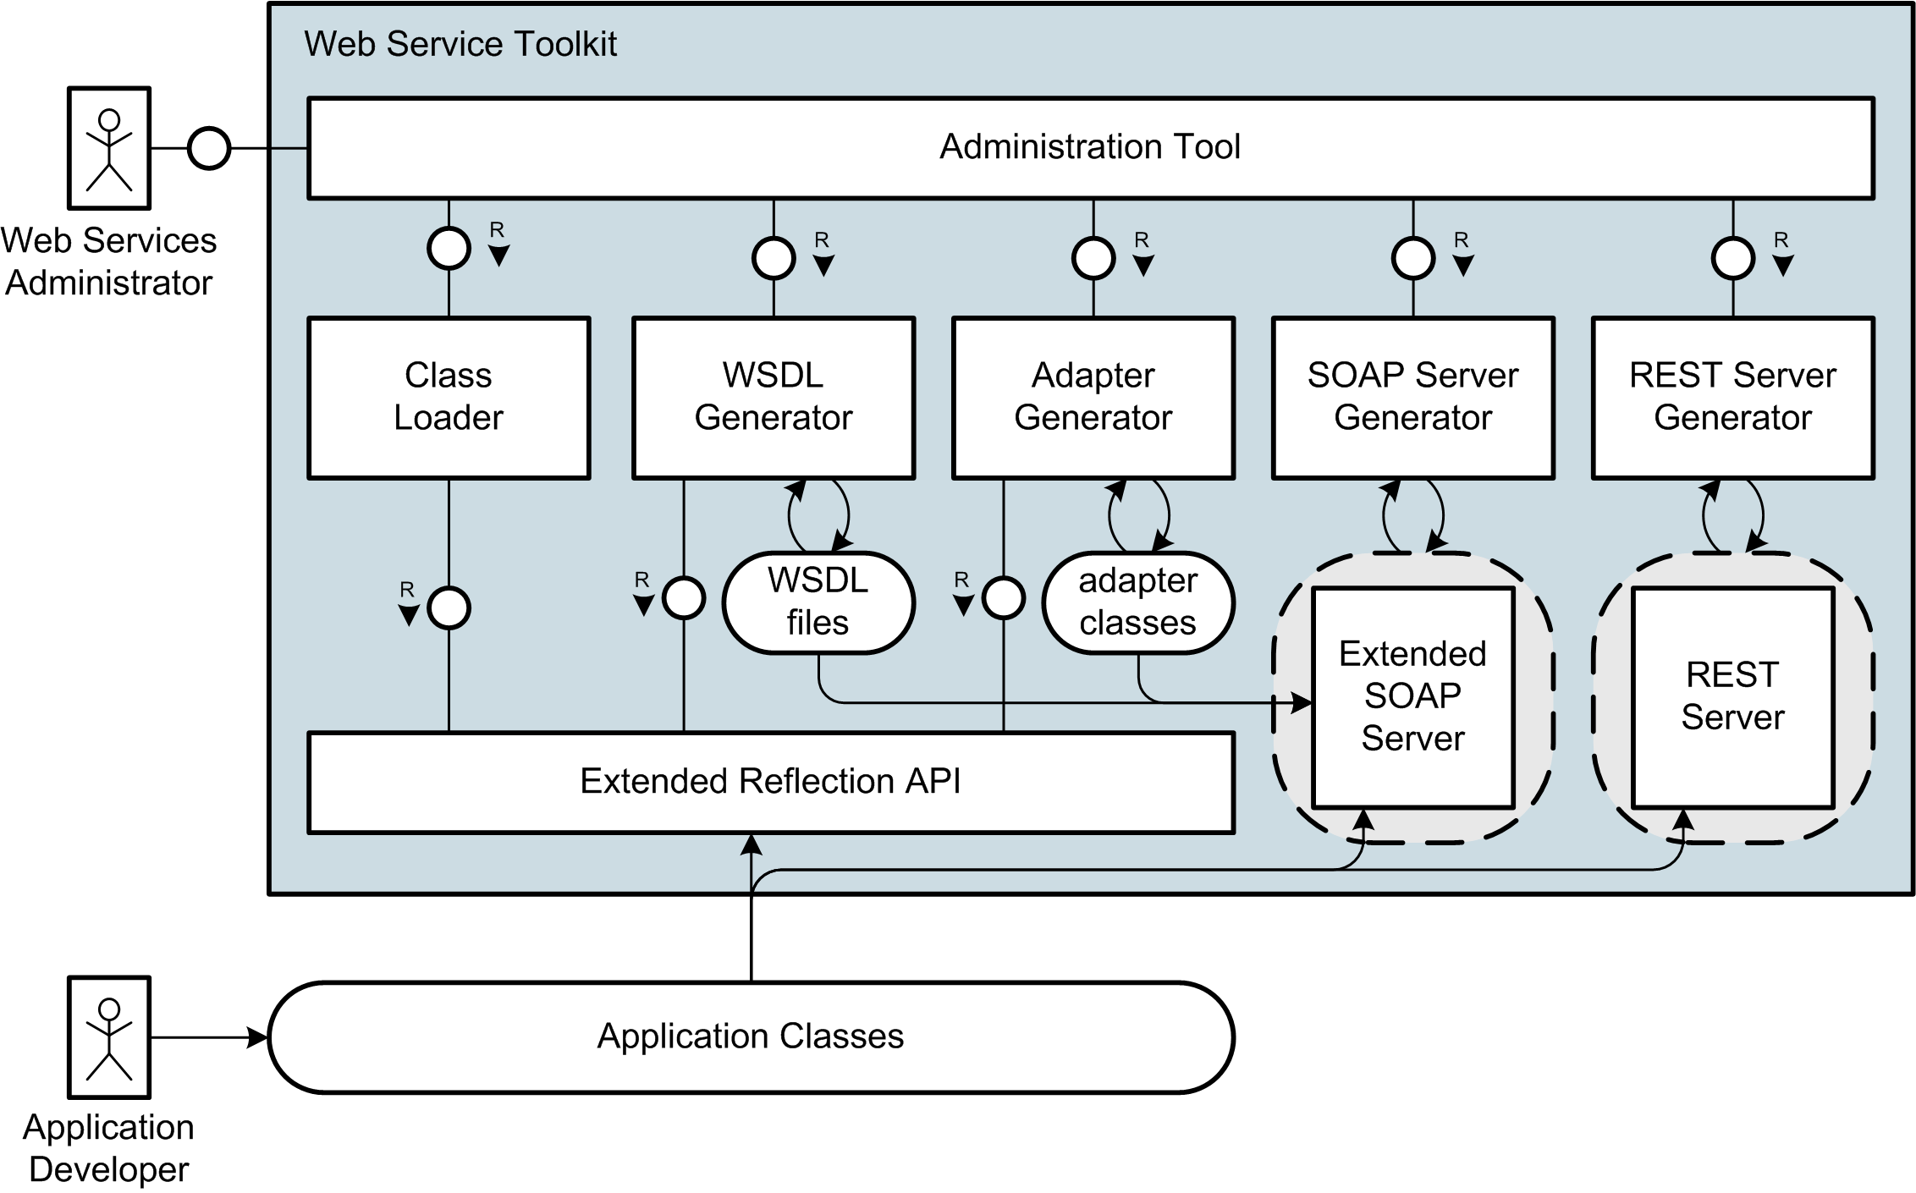
Interaction Overview

Slide 20
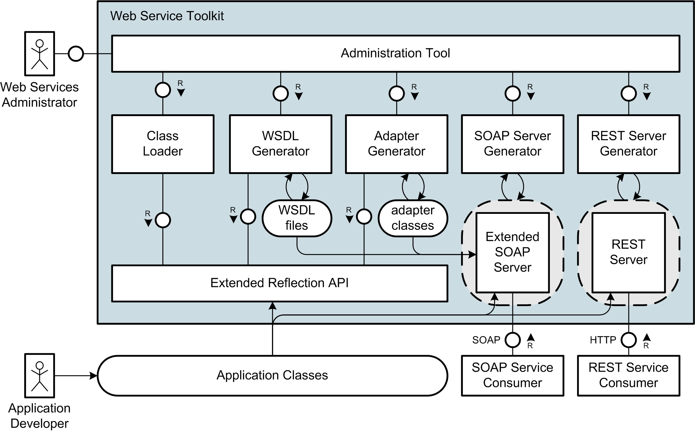
Interaction Overview

Slide 21
Live Demo

Slide 22
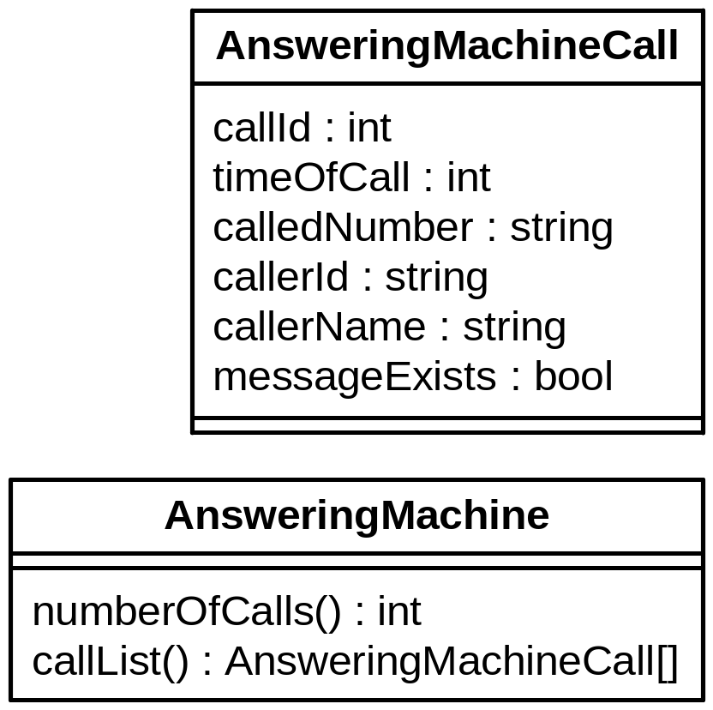
Live Demo

Slide 23
Example Application
  Application: Answering Machine
    Number of Calls
    List of Calls
  Example Web Service
    using SOAP Protocol
Notes:
Wichtige Punkt für solch einen Web Service
Gesichert durch Authentifizierung
Hier einfaches user/passwort
Je nach scenario vielleciht auch über client-zertifikate usw.
Notwendig einerseits für zugriffskontrolle
Andererseits fürs Abbrechnen der Zugriffe/Billing

Slide 24
Generation Steps
  Creating Web Services without Tool Support:
    Create XML Schema for Data Types
    Write WSDL Description
    Own Wrapping for Document/Literal
    Include Documentation
    Build SOAP Server Script
    No WS-Security Support
  InstantSVC automates all Steps

Slide 25
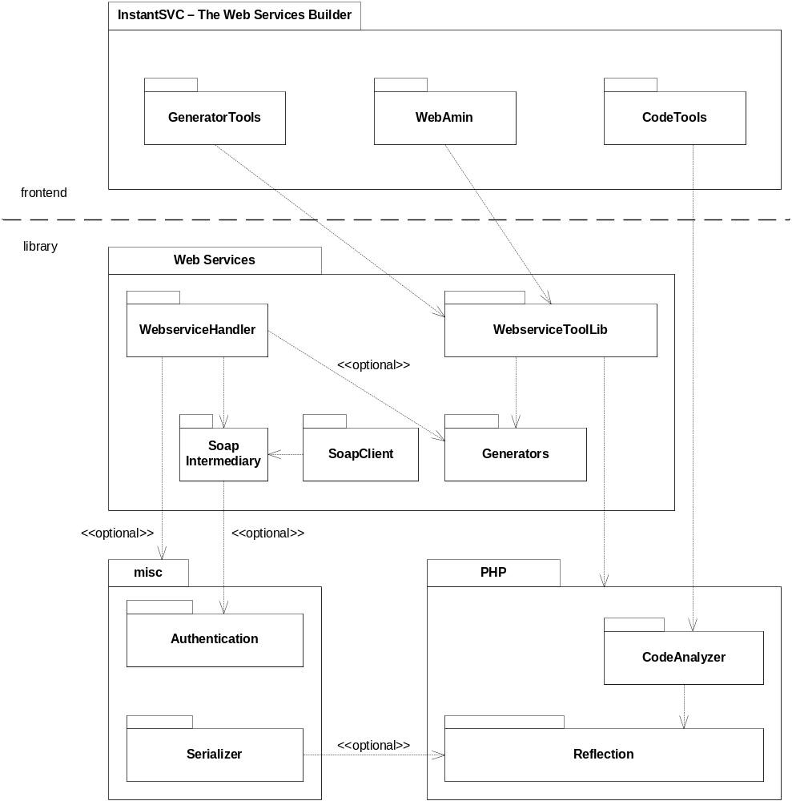
Components of InstantSVC

Slide 26
Summary

Slide 27

Further Information and Download at:
http://instantsvc.sourceforge.net

Slide 29
Suggested Reading
White Papers
[1] Einführung in XML Web Services, October 2005
[2] Web Services Facade for PHP5 – Konzeption, January 2006
[3] Web Service Toolkit für PHP5, March 2006
download at http://instantsvc.sf.net/
Further Sources
[4] RESTful Web Services, January 2006
http://www.stefan-marr.de/artikel/restful-web-services.html
[5] SOAP Version 1.2 specification, W3C Recommendation, June 2003. http://www.w3.org/TR/soap/
[6] Web Services Description Language (WSDL) 1.1, W3C Note, March 2001. http://www.w3.org/TR/wsdl/
[7] Username Token Profile 1.0, OASIS, January 2004
http://docs.oasis-open.org/wss/2004/01/oasis-200401-wss-username-token-profile-1.0.pdf

Slide 30
BACKUP Slides

Slide 31
The Core Web Services Protocol Stack
Discovery | UDDI (Itself a Web Service)
Description | WSDL, WSFL/XLANG, others to come
Access | SOAP, SOAP with Attachments, XML-RPC, REST
Transfer | HTTP, SMTP, FTP, others
Transport | TCP/IP, UDP, others

Slide 32
Components of InstantSVC

